Slide 1

Biomaterials: Surface Characterization
Louisiana Tech University
College of Engineering and Science
BIEN 235
Dr. Teresa Murray

Slide 2
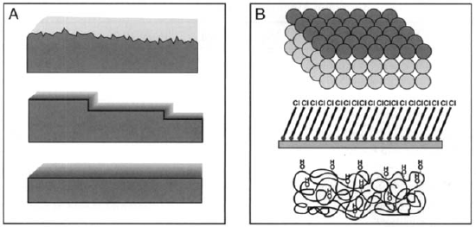
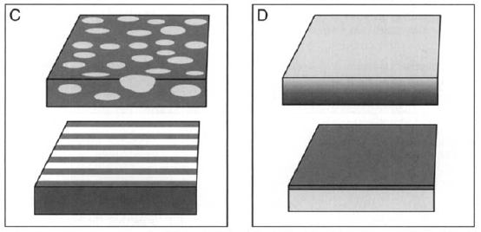
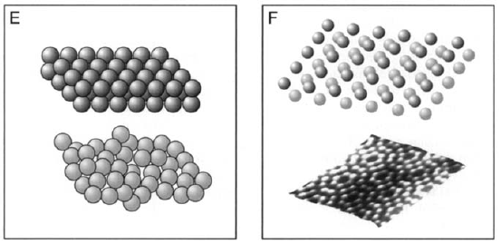
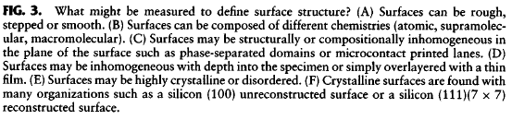
Louisiana Tech University
College of Engineering and Science
Surface structure affects tissue interaction-reaction
Figures from text: Ratner et al., 2004
Notes:
Describe the different surface structures shown in the figure (use the information in the caption – they won’t be able to see the caption in the classroom).
Some surface structures and surface chemistries are more prone to protein adsorption than others. Also cells contacting these surfaces may grow well on some surfaces and not on others.

Slide 3
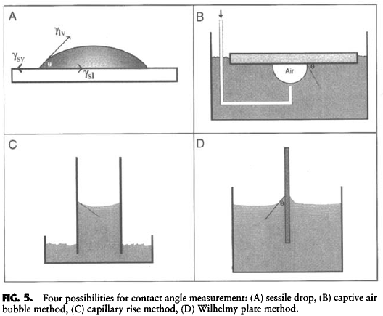
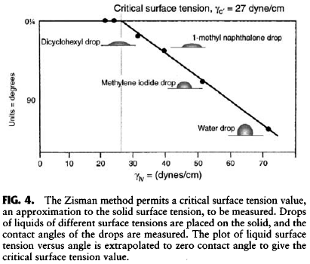
Louisiana Tech University
College of Engineering and Science
Contact angle tests for surface chemistry
Figures from text: Ratner et al., 2004

Slide 4
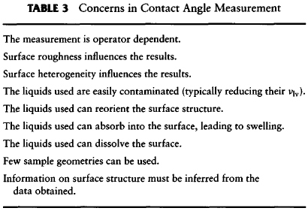
Louisiana Tech University
College of Engineering and Science
Table from text: Ratner et al., 2004

Slide 5
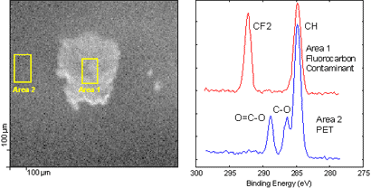
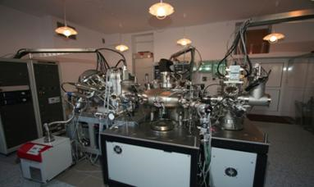
Louisiana Tech University
College of Engineering and Science
Surface analysis using electron spectroscopy for chemical analysis (ESCA, a.k.a. x-ray photoelectron spectroscopy, XPS)
Fig. 2: High resolution carbon 1s spectra from the same selected areas that show the presence of a fluorocarbon contamination in localized areas on the polymer surface.
http://ichf.edu.pl/res/res_en/labs/Lab_6_xps/Lab_xps_pliki/image016.jpg
http://www.phi.com/surface-analysis-techniques/xps.html

Slide 6
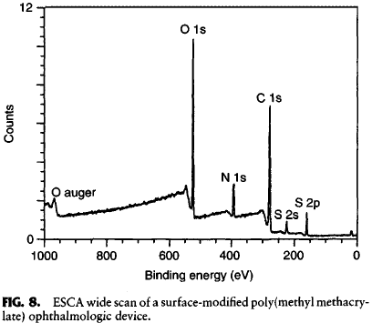
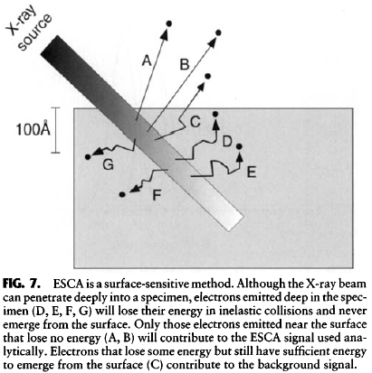
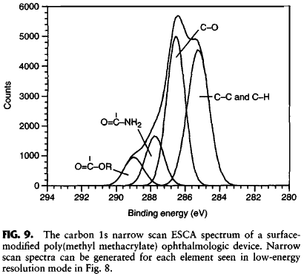
Louisiana Tech University
College of Engineering and Science
ESCA
Compute elemental ratios
No N or S in PMMA
High vacuum ~10⁻¹⁰ torr
Figures and tables from text: Ratner et al., 2004

Slide 7
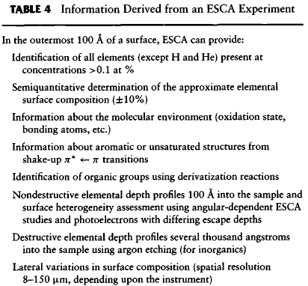
Louisiana Tech University
College of Engineering and Science
c
Table from text: Ratner et al., 2004

Slide 8
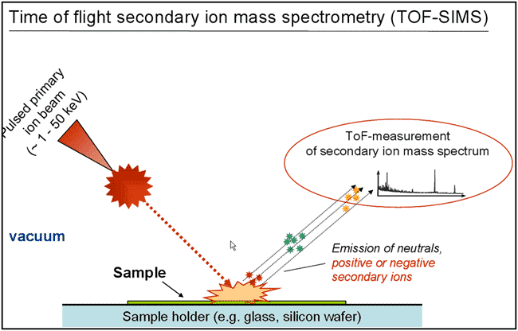
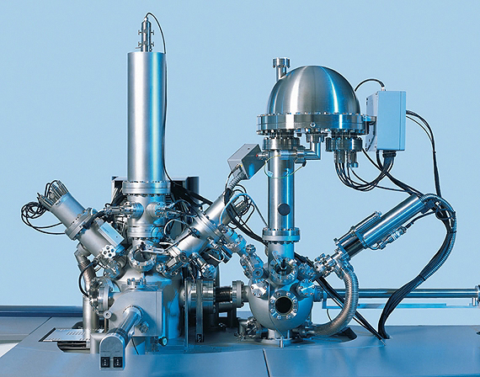
Louisiana Tech University
College of Engineering and Science
Surface analysis using time-of-flight secondary ion mass spectrometry (TOF-SIMS)
http://www.geomuseum.uni-goettingen.de/people/vthiel/images/tof_sims1.gif
https://www.iontof.com/customised-products-tof-sims-custom-made-configurations.html

Slide 9
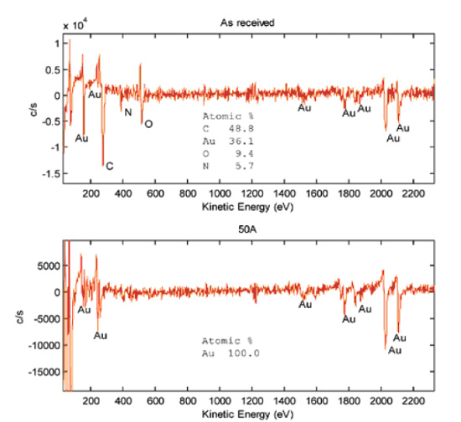
Louisiana Tech University
College of Engineering and Science
TOF-SIMS
Static SIMS
Identifies species of ions on surface of materials
Top sample has organic contaminant
http://www.wintech-nano.com/photos/Auger_1.jpg

Slide 10
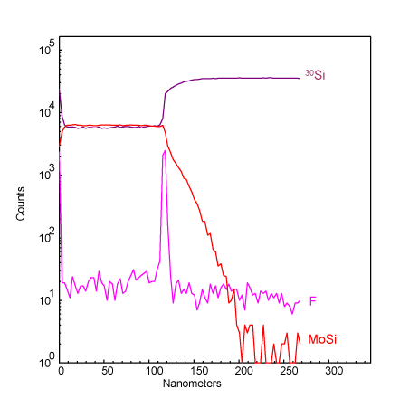
Louisiana Tech University
College of Engineering and Science
TOF-SIMS
Dynamic SIMS
TOF-SIMS sputter depth profile of MoSi ₂ thin film on Si shows presence of fluorine contaminant at film/substrate interface
http://kompozite.com/2014-03-29/tof-sims.html

Slide 11
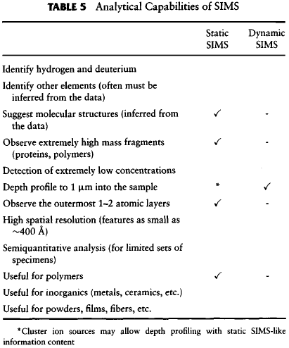
Louisiana Tech University
College of Engineering and Science
Table from text: Ratner et al., 2004

Slide 12
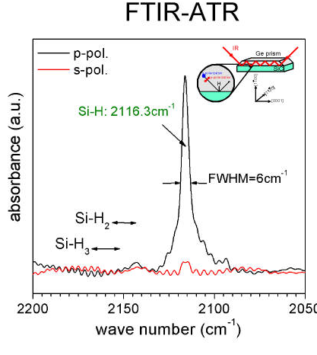
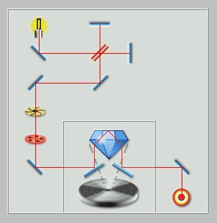
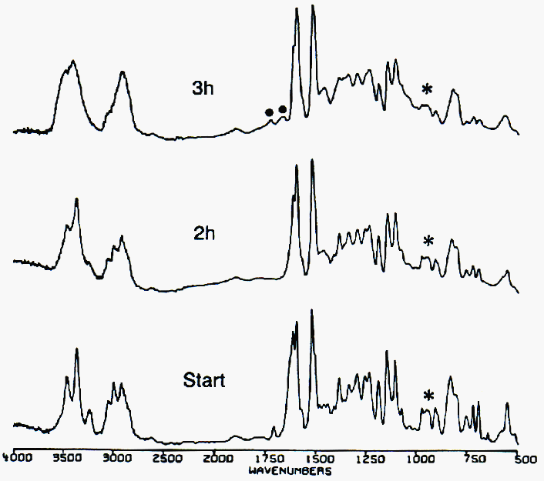
Louisiana Tech University
College of Engineering and Science
Surface analysis using Fourier transform infrared analysis with attenuated total reflectance (FTIR-ATR) for chemical analysis
Observation over time
(e.g., curing epoxy)
Left and upper right images: http://www.viewgoods.co.uk/general/ftir-atr.html
Lower right image:
http://www.pslc.ws/macrog/mpm/analysis/ftiratr.htm

Slide 13
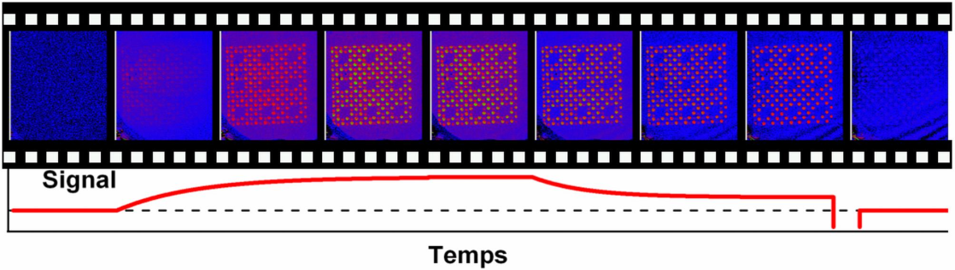
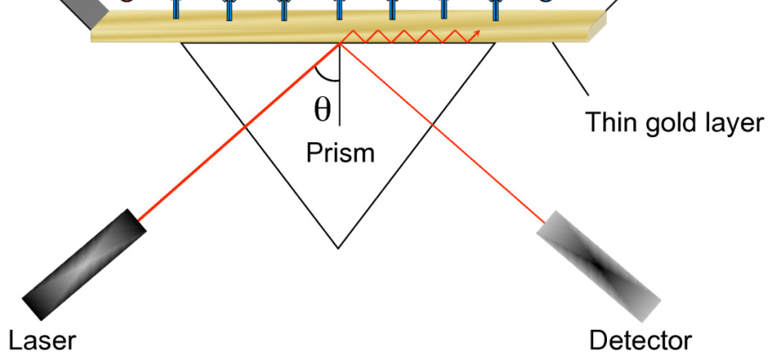
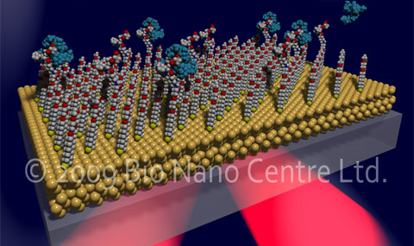
Louisiana Tech University
College of Engineering and Science
Surface plasmon resonance (SPR) can capture changes in analyte over time and various conditions
www.photonics4life.eu/var/plain_site/storage/images/consortium/p4l-database/all-items/genetic-diagnostic-using-spri-surface-plasmon-resonance-imaging/13509-5-eng-
US/Genetic-diagnostic-using-SPRI-Surface-Plasmon-Resonance-Imaging.jpg
http://www.drugdevelopment-technology.com/
contractor_images/bio-nano/3-bio-nano.jpg
http://respiratory-research.com/content/10/1/29/figure/F3?highres=y

Slide 14
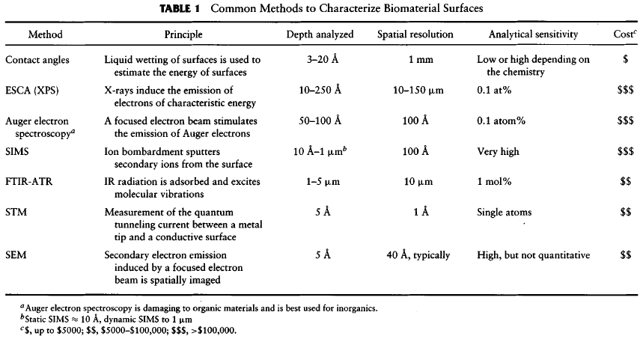
Louisiana Tech University
College of Engineering and Science
Note: These prices are outdated. However, it is probably valid to use for comparison.
Table from text: Ratner et al., 2004

